Slide 1
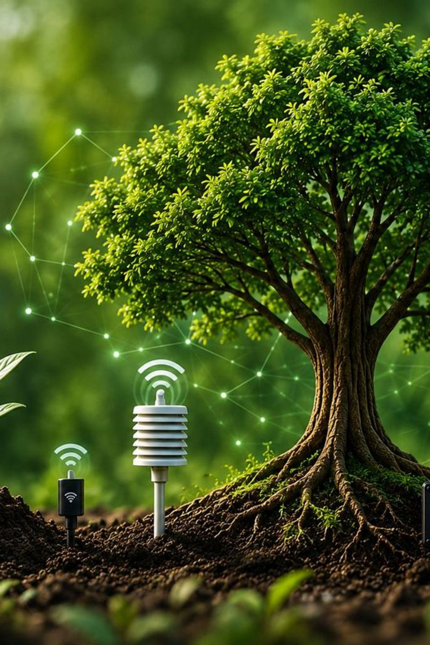
TreeGuard
Smart IoT-Based Tree Health Monitoring System
Real-Time Monitoring of Tree Conditions Using IoT
1· K. VISHNU VARDHAN REDDY
2· L. NAGA HARSHITHA
3. L. SIVA LAKSHMI
4. CH.HARISH
B.Tech – Department of CSE · Kalasalingam Academy of Research and Education

Slide 2
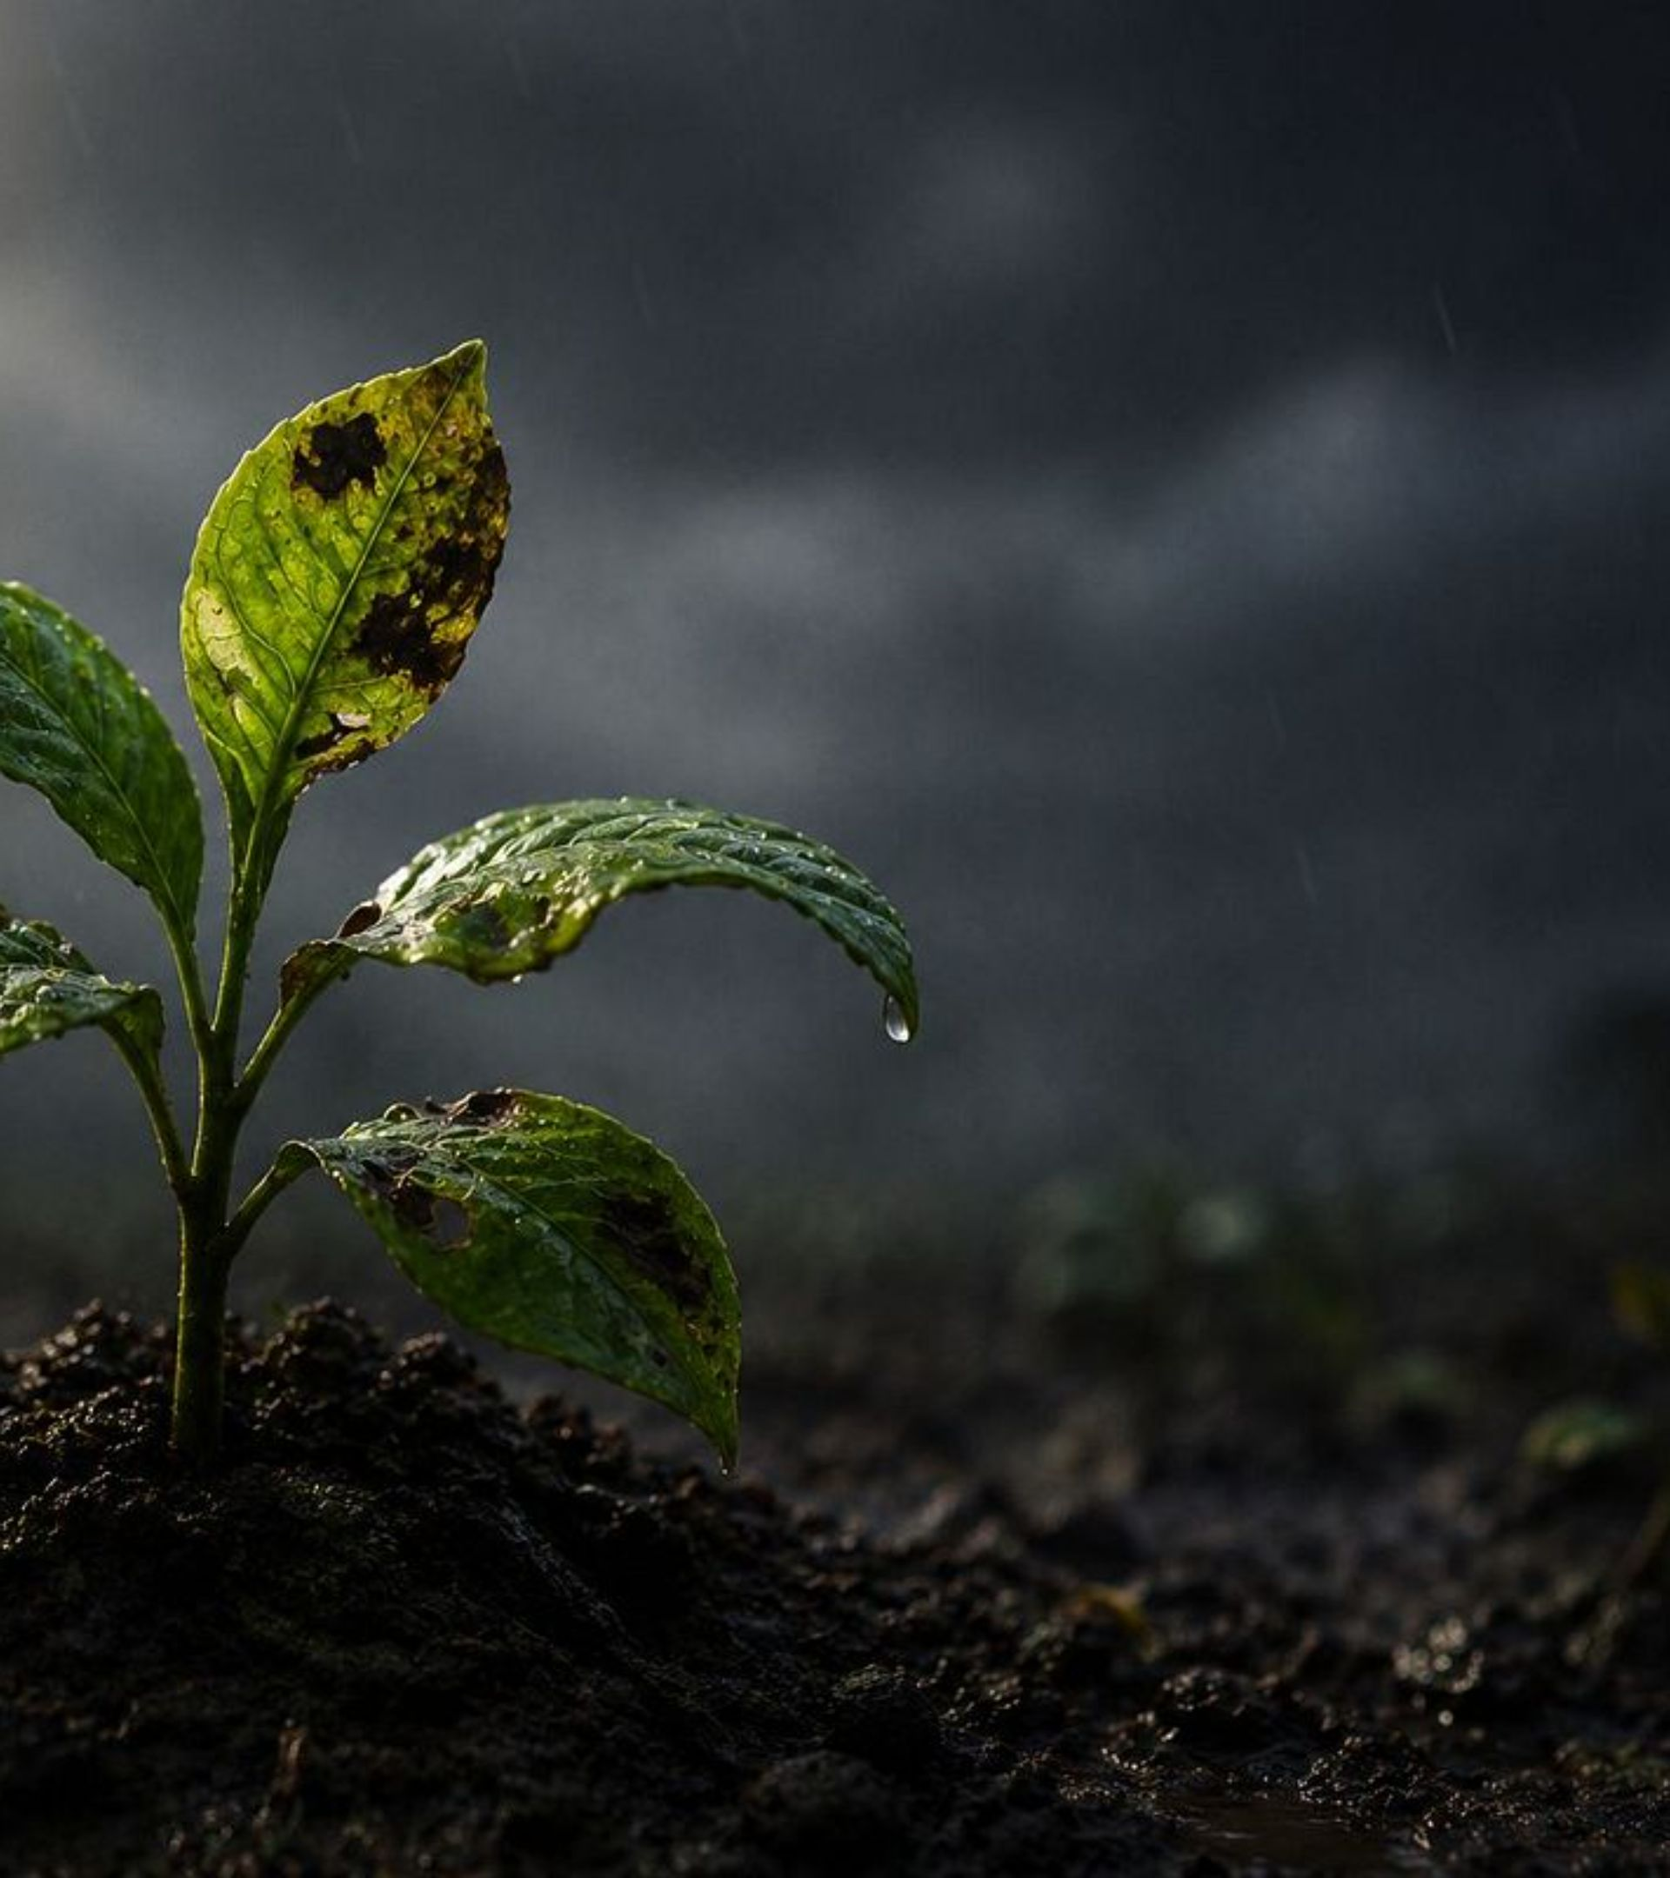


CHALLENGE
The Problem
Manual Inspection Only
Trees are commonly monitored through time-consuming, labor-intensive manual inspection.
Unnoticed Changes
Shifts in environmental conditions often go undetected between inspection cycles.
No Continuous Coverage
Early identification of unfavorable conditions is difficult without dedicated resources.
A simple IoT-based system for continuous and remote tree-environment monitoring is needed.

Slide 3
Project Objectives
Monitor Continuously
Collect & Process
Measure soil moisture, temperature, humidity, soil temperature, light, rainfall, and air quality — without interruption.
Use the ESP32 microcontroller to read sensor data and manage data flow locally.
Transmit Wirelessly
Alert Early
Send data securely to the Blynk IoT cloud platform over Wi-Fi.
Identify abnormal environmental conditions early through configurable threshold-based notifications.

Slide 4




SOLUTION OVERVIEW
Our Solution
Sensors → ESP32 → Wi-Fi → Blynk Cloud → Mobile Dashboard → Alerts
Sensors
ESP32
Collect environmental data from tree surroundings
Processes readings and manages data flow
Blynk Cloud
Alerts
Live readings, graphs, and historical trends
Configured thresholds trigger instant notifications

Slide 5
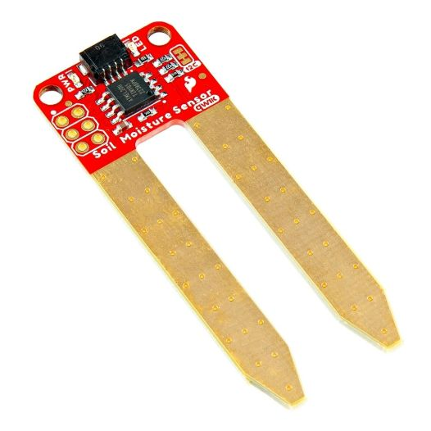
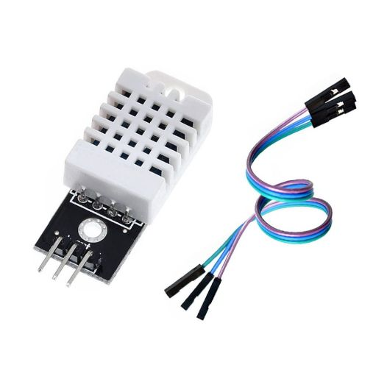
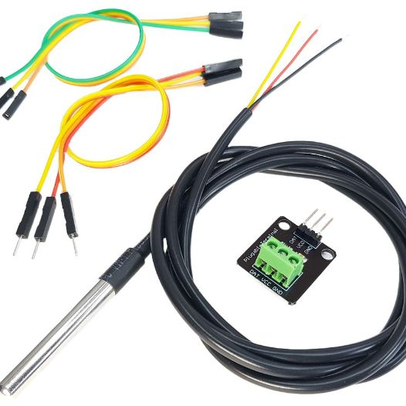
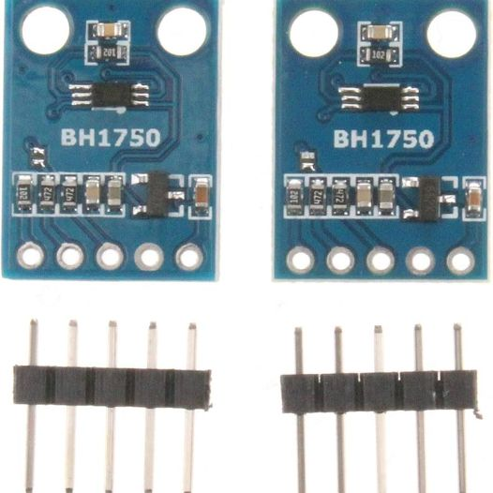
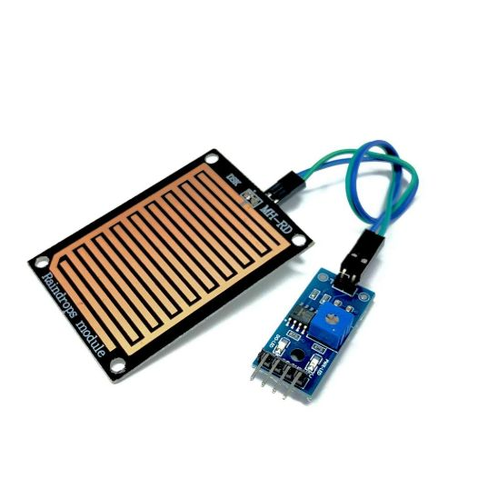
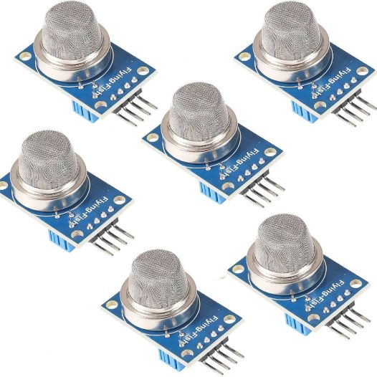
Sensors Used
Professional product photos of the six sensor components used in the system.
Soil Moisture Sensor
DHT22
DS18B20
Measures soil moisture levels around the root zone
Measures ambient temperature and relative humidity
Measures soil temperature at root depth
BH1750
Rain Sensor
MQ-135
Measures light intensity in lux for photosynthesis monitoring
Detects rainfall and water presence on sensor surface
Indicates air quality and gas changes in the environment

Slide 6
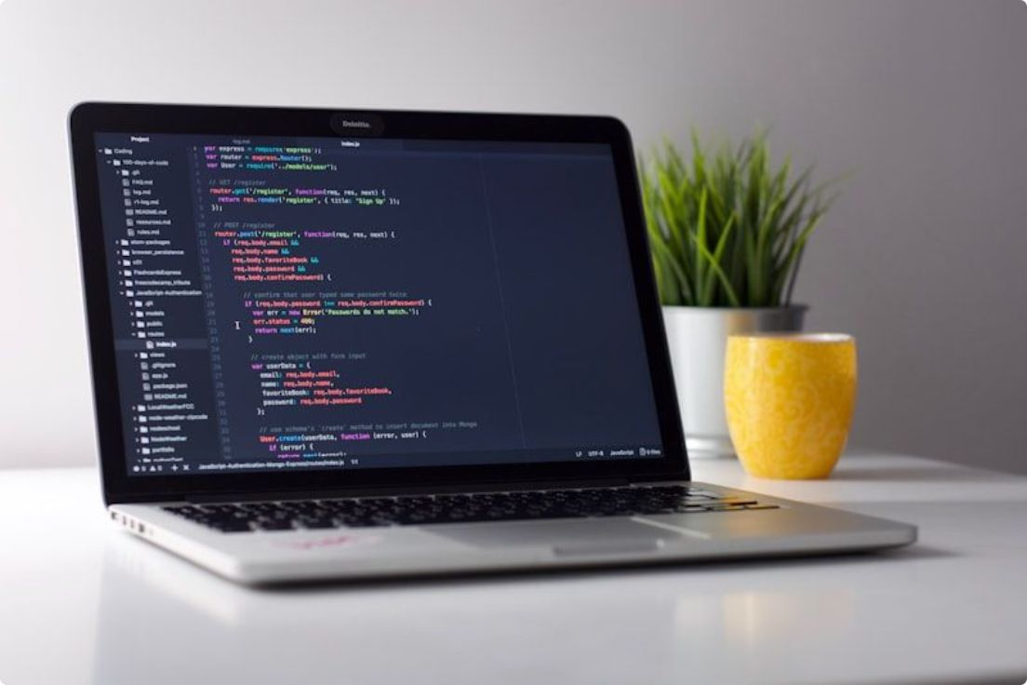
STACK
Hardware & Technology
Main Controller
ESP32 Development Board — Microcontroller with built-in Wi-Fi that processes sensor data and transmits to Blynk cloud.
Sensors & Components
Soil Moisture · DHT22 · DS18B20 · BH1750 · Rain Sensor · MQ-135
Breadboard, Jumper Wires, Power Supply (5V / 3.3V)
Software & Platform
Arduino IDE — Firmware development and deployment
Blynk IoT — Cloud connectivity and live visualization
Wi-Fi / Internet — Wireless data transmission

Slide 7


ARCHITECTURE
System Architecture
Tree / Environment
Source of all environmental parameters surrounding the tree
Mobile Dashboard & Alerts
Tree / Environment
Source of environmental parameters
Sensor Layer
User visualization and notifications
Six sensors capture soil, atmospheric, light, rain, and air quality data
Blynk Cloud Platform
Sensor Layer
Real-time Data Flow
Soil, DHT22, DS18B20, BH1750, Rain, MQ-135
ESP32 Microcontroller
Cloud storage and processing
Reads, processes, and manages all incoming sensor signals
ESP32 Microcontroller
Blynk Cloud
Wi-Fi Network
Receives data over Wi-Fi and stores it for dashboard and alerting
Secure data transmission link
Data aggregation and preprocessing
Mobile Dashboard
Real-time environmental data flow from tree surroundings to the user
User-facing interface showing live readings, graphs, and alerts

Slide 8
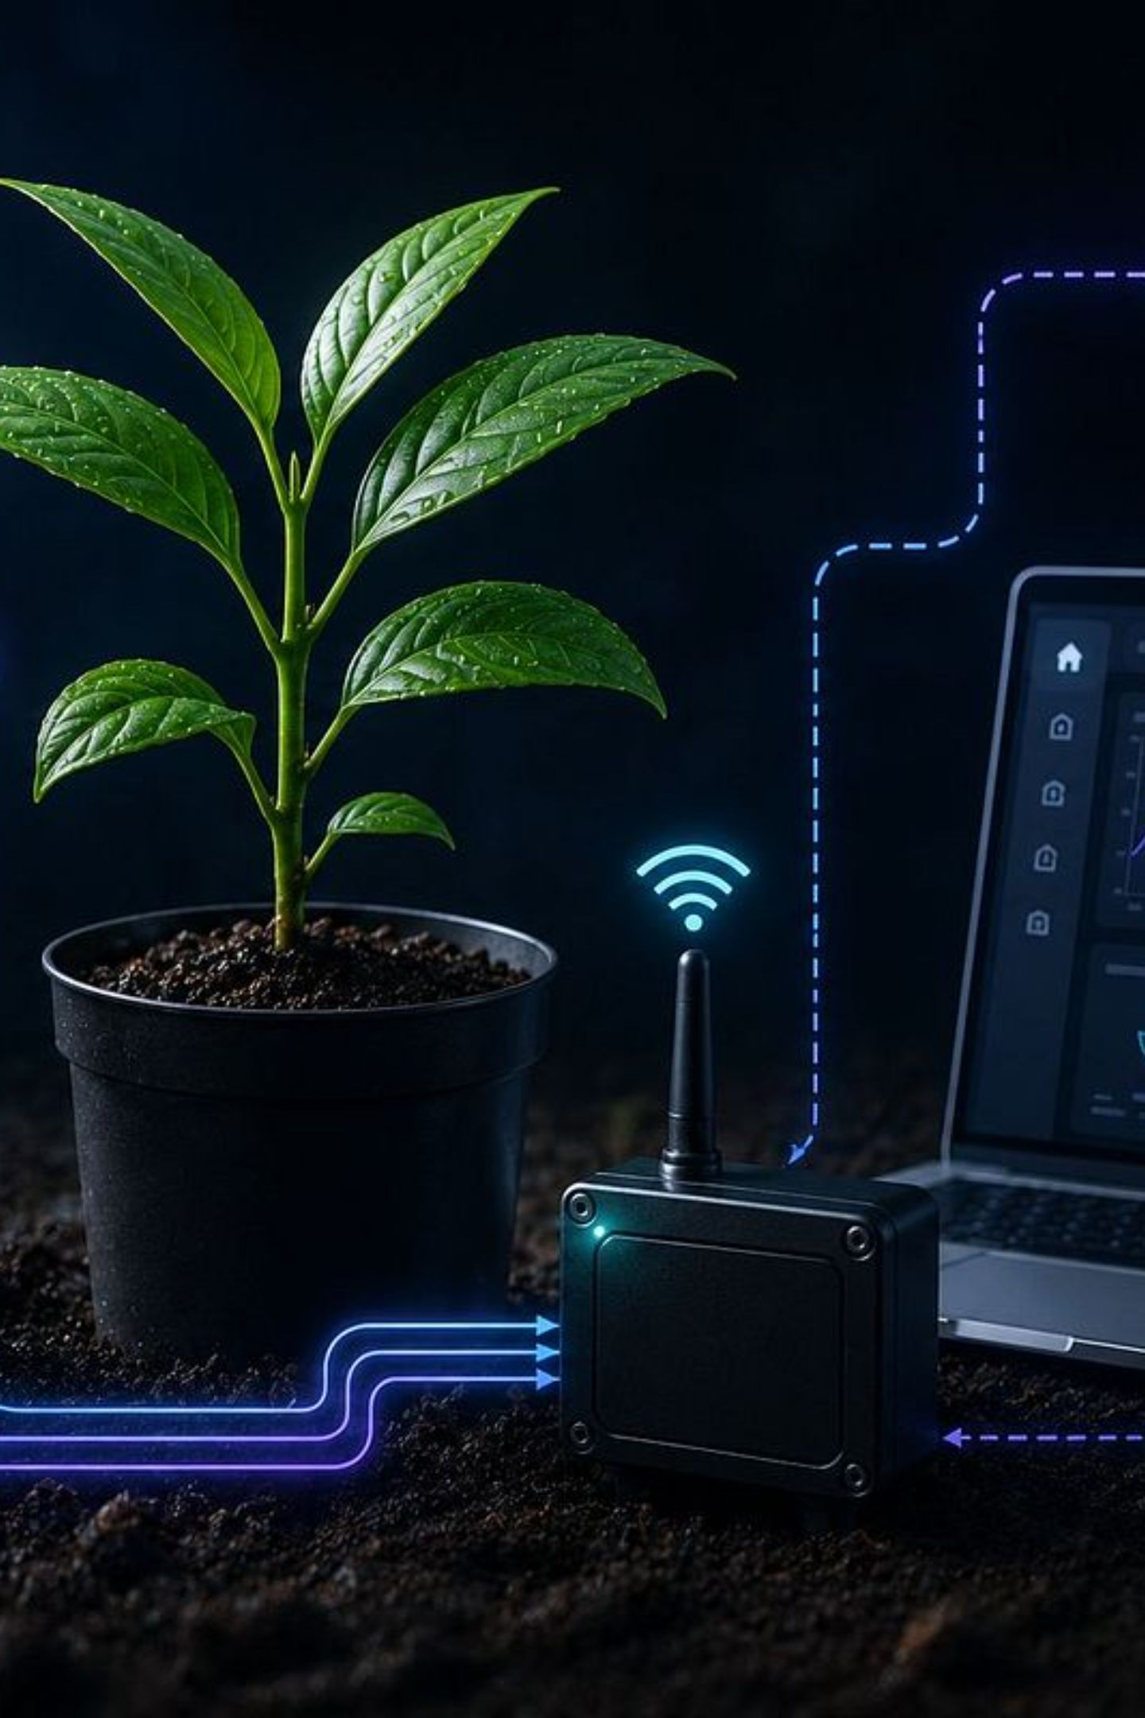





Working Principle
Sense Environment
Collect Data
Sensors detect surrounding conditions continuously
Raw readings gathered from all six sensors
Process Data
Send to Cloud
ESP32 processes and formats sensor values
Data transmitted wirelessly to Blynk platform
Monitor & Alert
Live dashboard displays readings and fires threshold alerts
TreeGuard continuously converts environmental conditions into real-time data for remote monitoring and early identification of abnormal conditions.

Slide 9
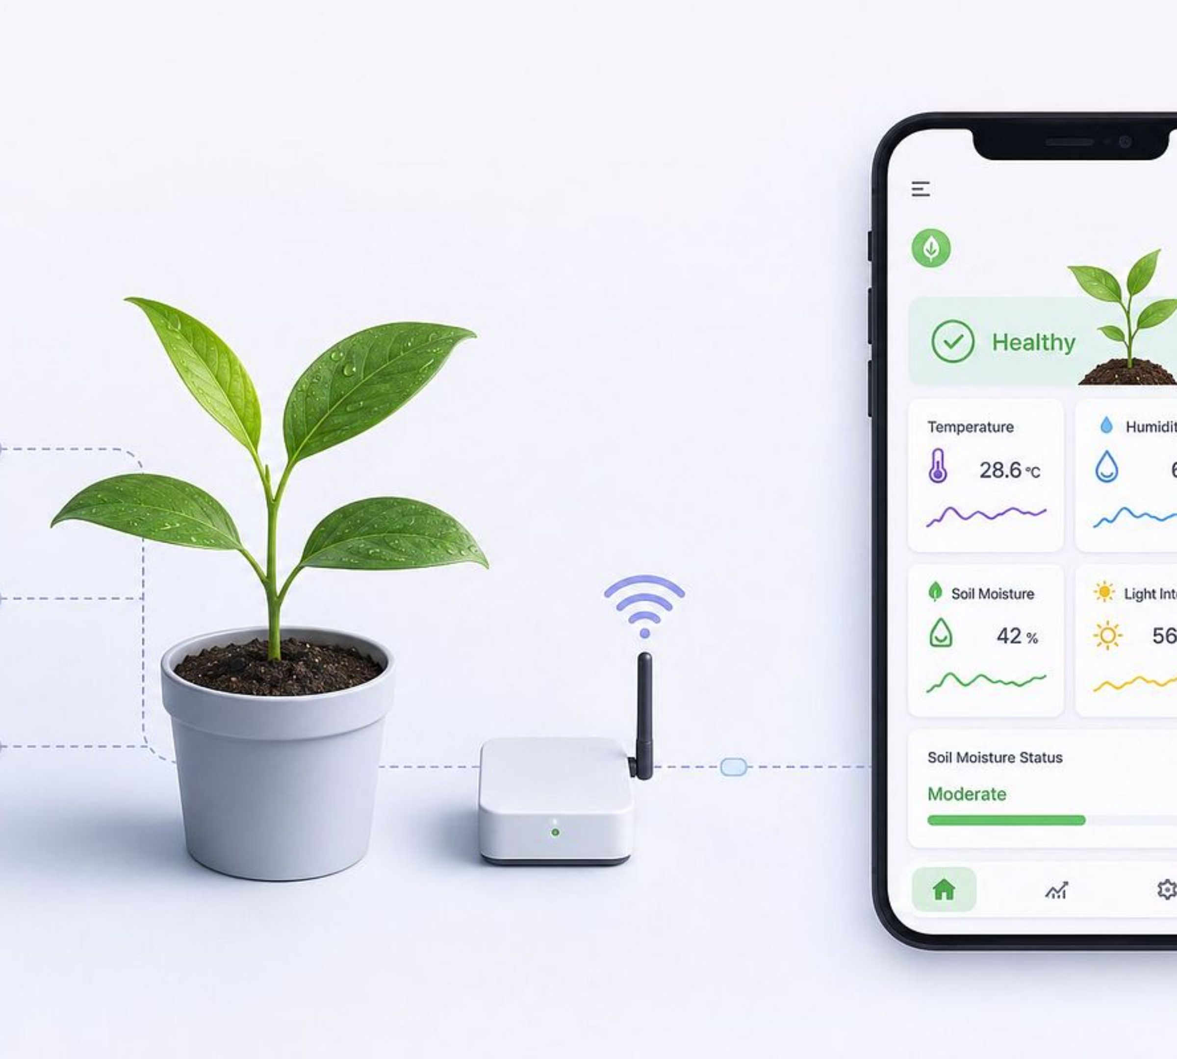

PLATFORM
Blynk IoT Monitoring
Live Dashboard
Shows real-time sensor values using interactive widgets on mobile
Graphs & Trends
Visualizes sensor history and trend analysis for all parameters
Remote Access
Monitor tree conditions from anywhere via Internet connectivity
Threshold Alerts
Sends push notifications when defined conditions are exceeded
Monitored: Temperature · Humidity · Soil Moisture · Soil Temperature · Light Intensity · Rainfall · Air Quality

Slide 10
VALIDATION
Experimental Testing & Results
Test Scenarios
Expected Results
Condition | Observed Behavior
Dry Soil | Low soil moisture readings
Wet Soil | High soil moisture readings
Normal Condition | Normal readings across all sensors
Higher Temperature | Temperature increase detected
Light Exposure | Change in light intensity measured
Rain / Water Contact | Rain detection triggered
Air Condition Changes | Change in MQ-135 output observed
✅ Real-time monitoring of all environmental parameters
✅ Wireless data transmission via Wi-Fi to Blynk cloud
✅ Live visualization and graphical analysis on mobile
✅ Detection of changing environmental conditions
✅ Configurable threshold-based alerts for abnormal conditions

Slide 11


Conclusion & Future Scope
Key Achievements
Future Scope
1
2
1
2
Smart Monitoring
Connected System
AI Prediction
Smart Irrigation
Continuous monitoring of environmental conditions around trees
ESP32 collects and transmits data through Wi-Fi to Blynk
ML-based tree health and stress prediction
Automatic irrigation triggered by soil moisture levels
3
4
3
4
Vision Detection
Large-Scale Monitoring
Remote Visibility
Practical Solution
Camera and computer vision for disease detection
GPS-enabled multi-tree monitoring across campuses
Real-time readings, graphs, and configurable alerts
IoT-based approach to smarter environmental monitoring
TreeGuard transforms traditional tree monitoring into a connected IoT-based monitoring system.

Slide 12
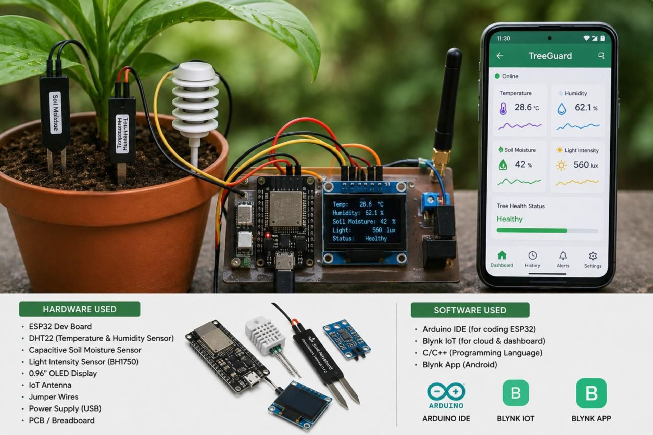
TreeGuard - Connecting Trees with Smart Technology

Slide 13
THANK YOU
Questions & Discussion
We appreciate your time and attention.
Contact: hello@treeguard.com

